Slide 1

Feast on beast
A Walk In My Tracks:
My journey as a hunter, and a culinary enthusiast

Slide 2
Overview

Slide 3

Goals of Feast On Beast:
Allow readers the ability to follow me on my journey as a hunter
Provide recipes for wild game and vegetation
Promote environmental control, and wellness

Slide 4
Volume of Hunting per Season
May Vary Based Off Location

Slide 5
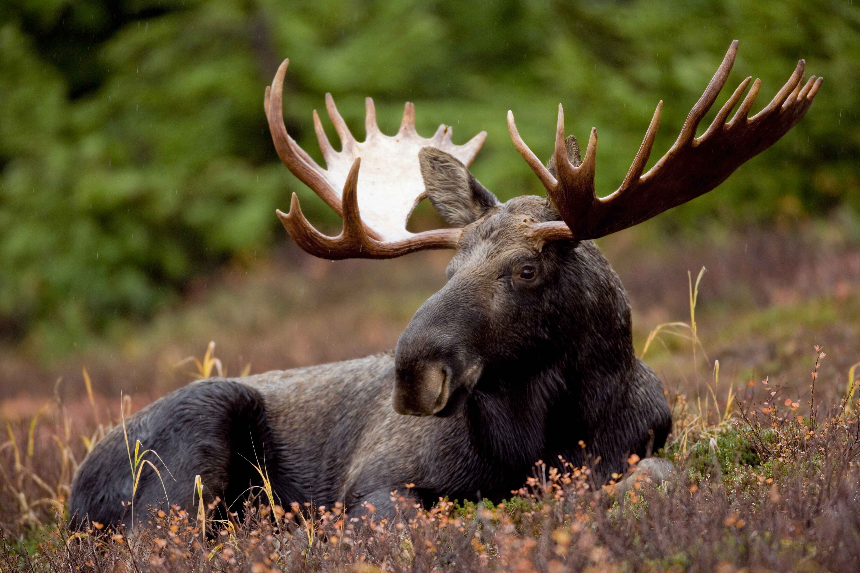


What is Feast On Beast
An interactive web application that will serve as a source of information for anyone interested in hunting, or the outdoors.
Will also host media options such as pictures, and videos that I will upload for the viewers entertainment.
Provides recipes for cooking wild game meats, and vegetation for all levels of expertise.

Slide 6
Optional information
What I Will Do For You
If the viewer decides to opt-in to the weekly newsletter that will notify them of the new content for the week, or wants the chance to win free prizes then all that I will need is:
Name
Email
That’s it!
Provide information on the different vegetation, and wild game that is available in a specific area
Educate readers on the importance of wildlife conservation
Post new recipes for all skill levels using all natural ingredients
Review the gear it is I purchase and use after rigorous testing.
Deliver instructional videos/photos

Slide 7
Diagrams

Slide 8
Entity Relationship Diagram
Delete
Media
Recipes
Username
Post
Website / Content
Admin
Manages
Views
User
Password
Edit
Blog
Gear

Slide 9
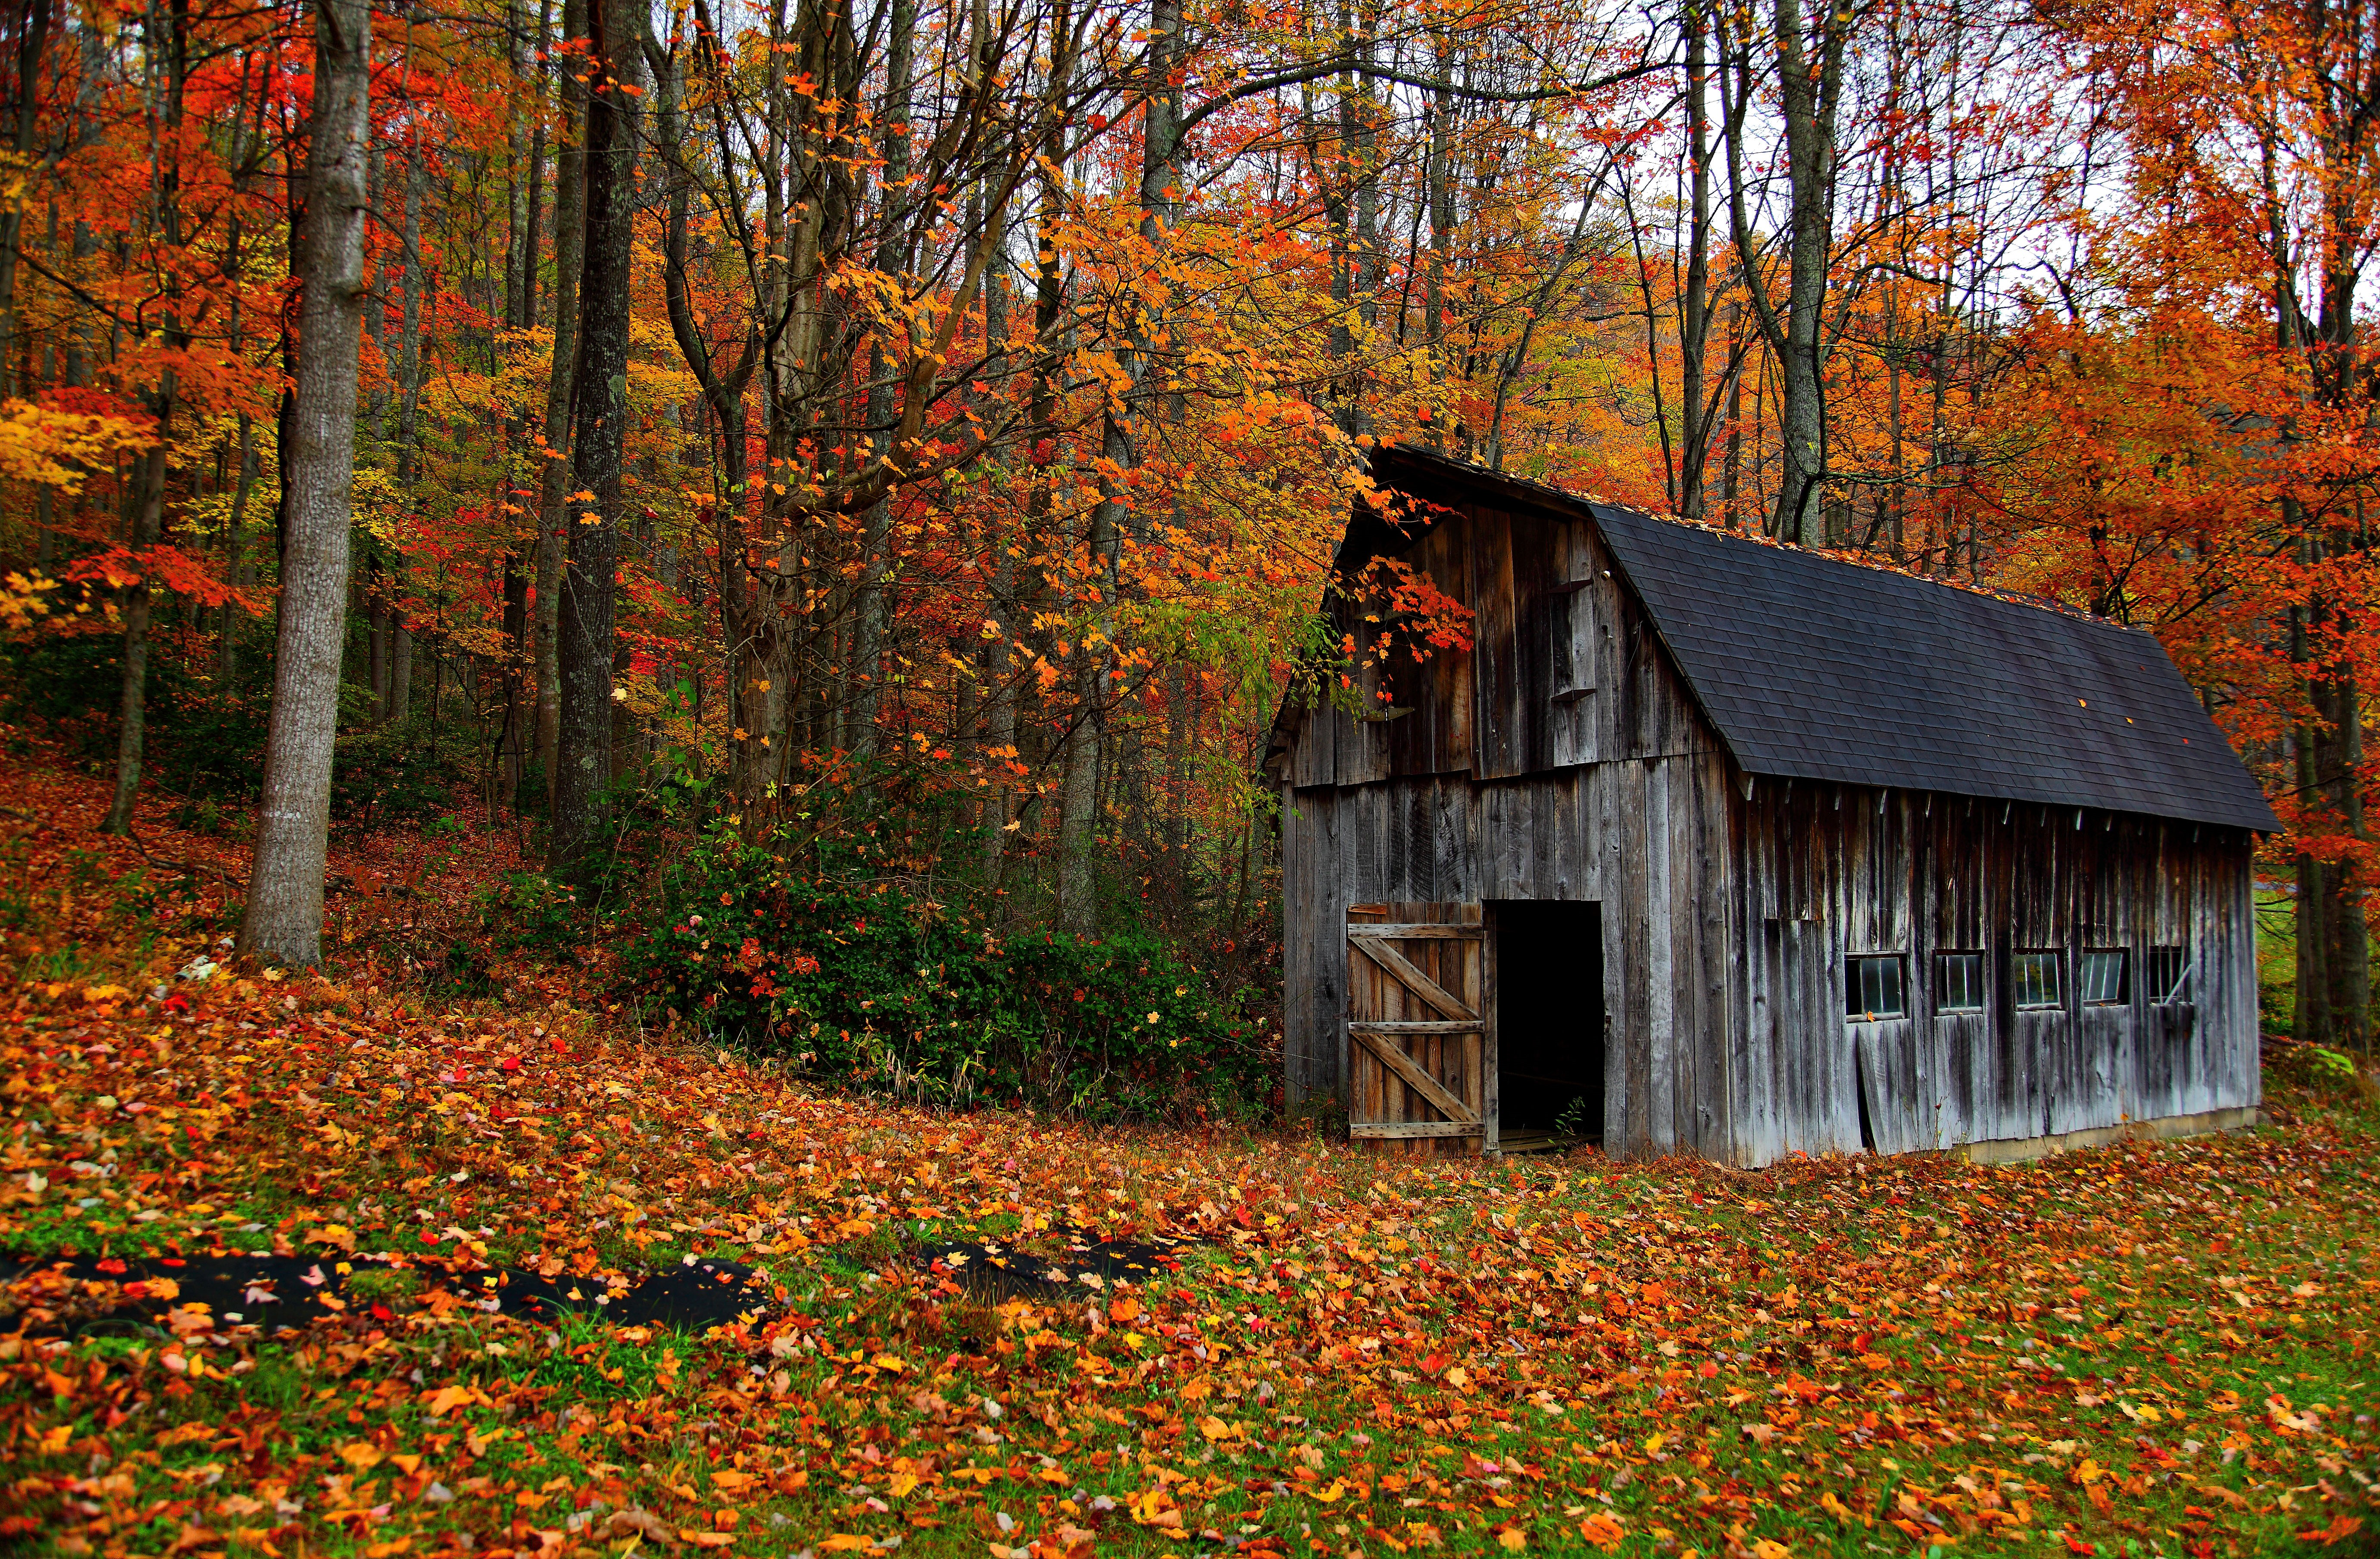
Composite Structure Diagram: Collaboration Use Diagram
blog : Post
admin: Role
user : Role

Slide 10
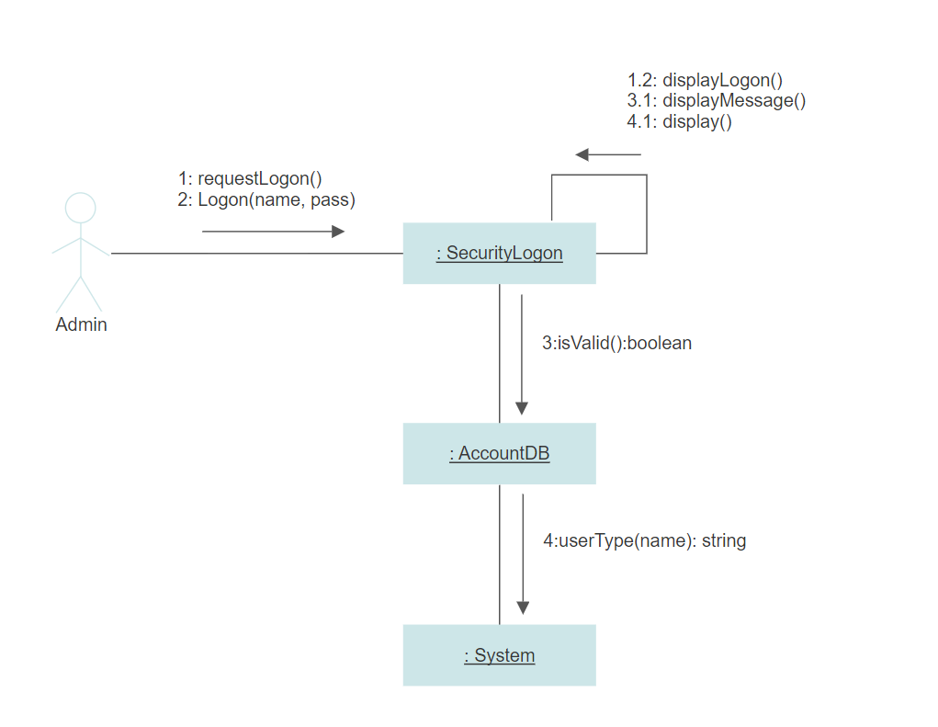
Communication Diagram: Admin Log-On Scenario

Slide 11
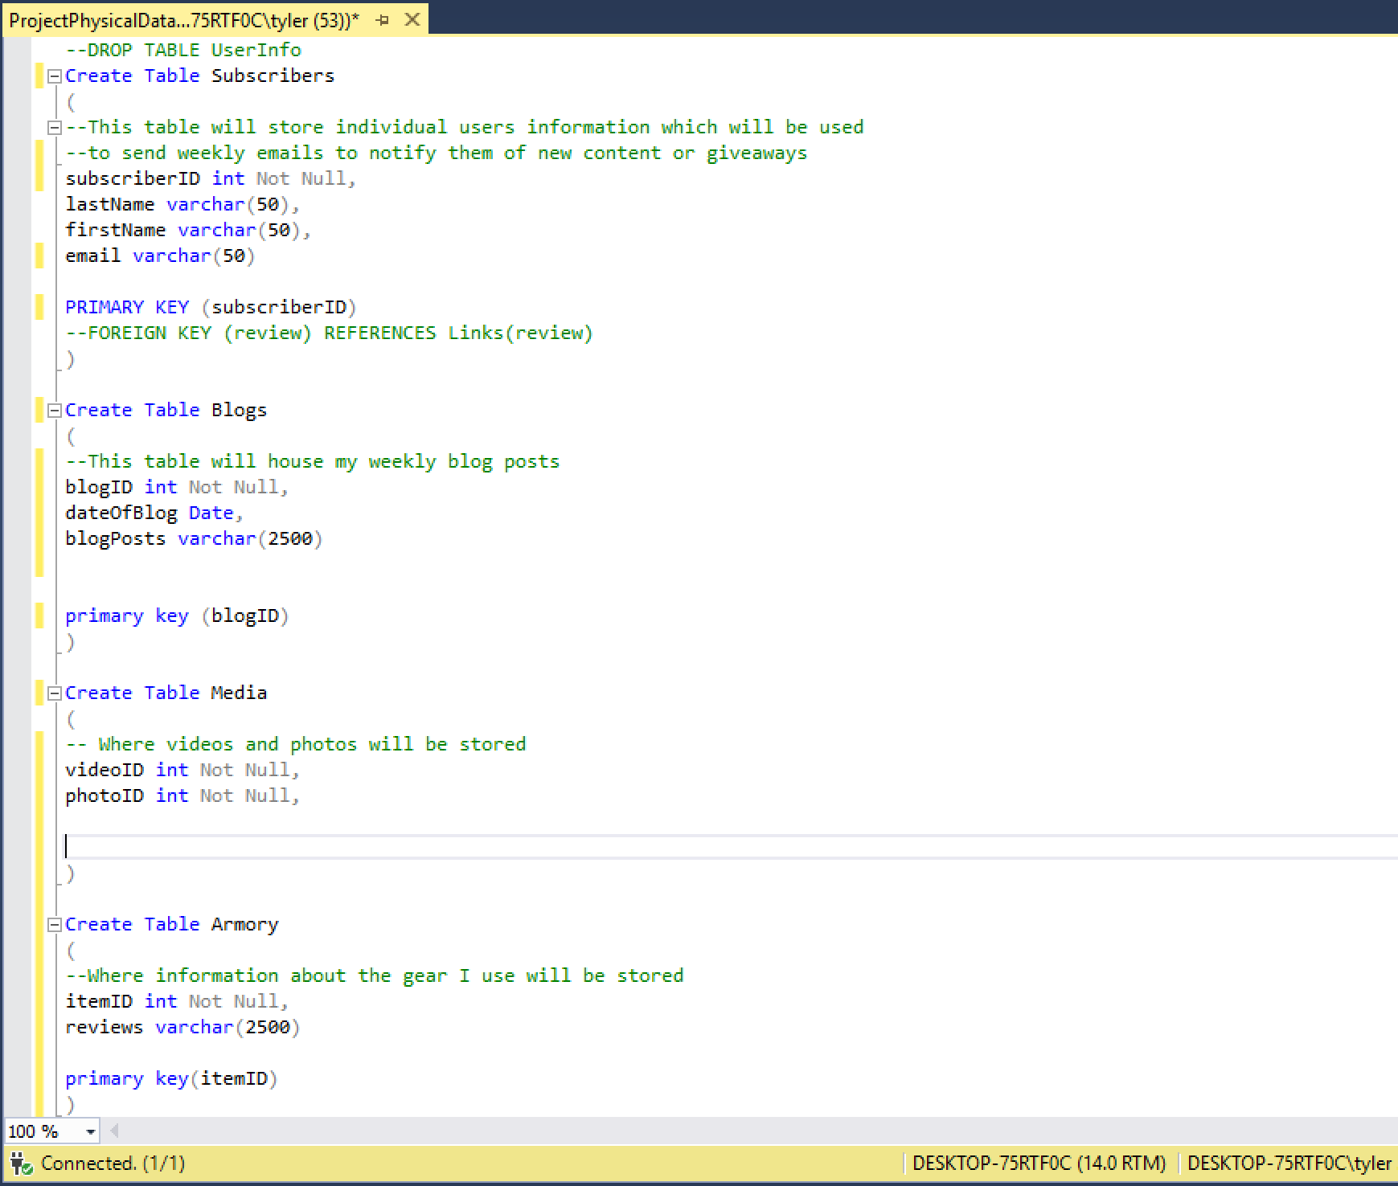
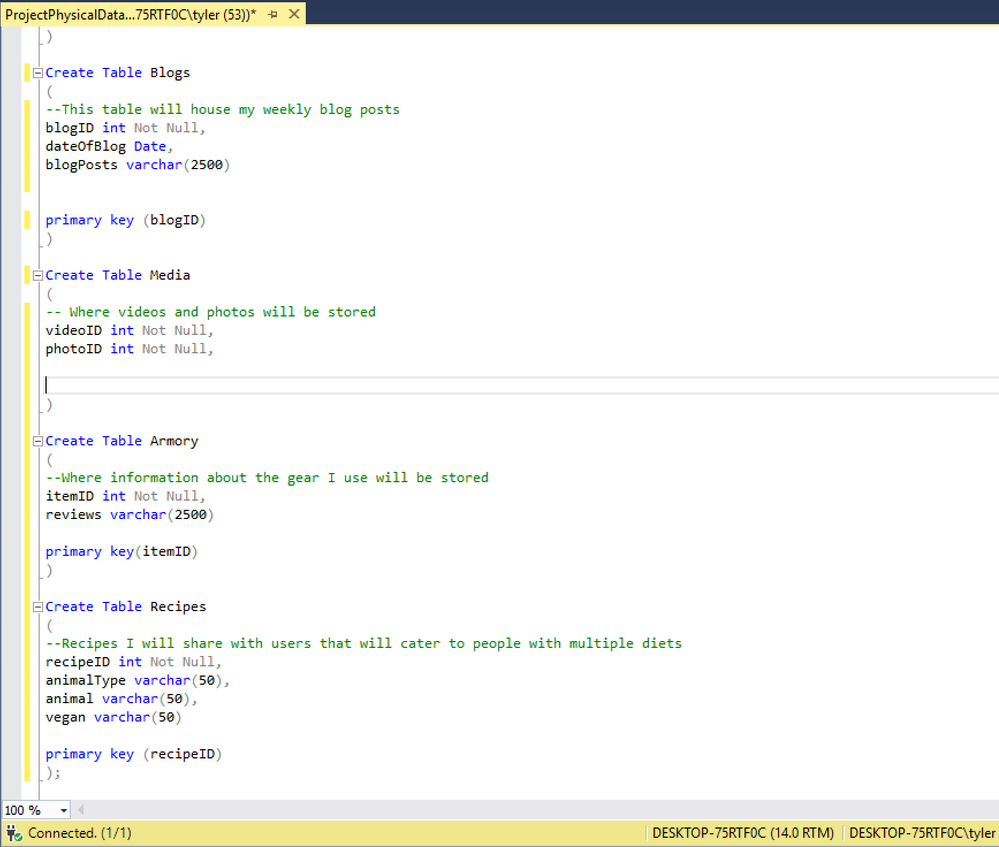
Physical Database Script
Pic 1
Pic 2

Slide 12
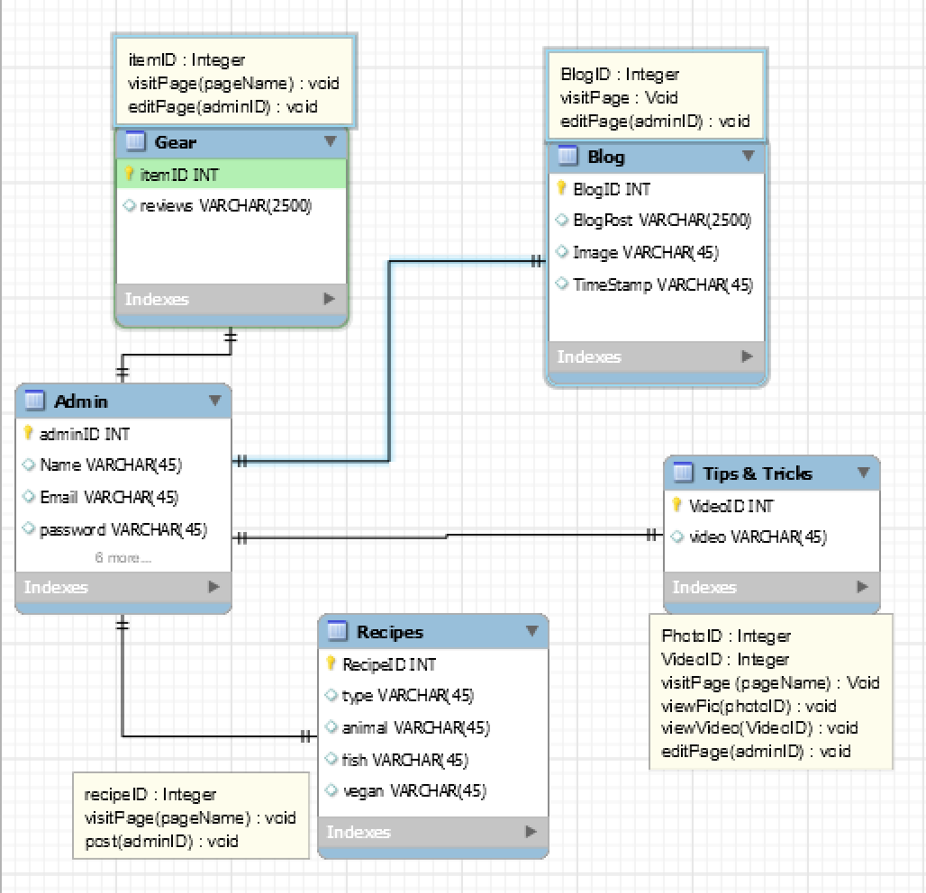
Data Model Class

Slide 13
User Story & Use Case

Slide 14
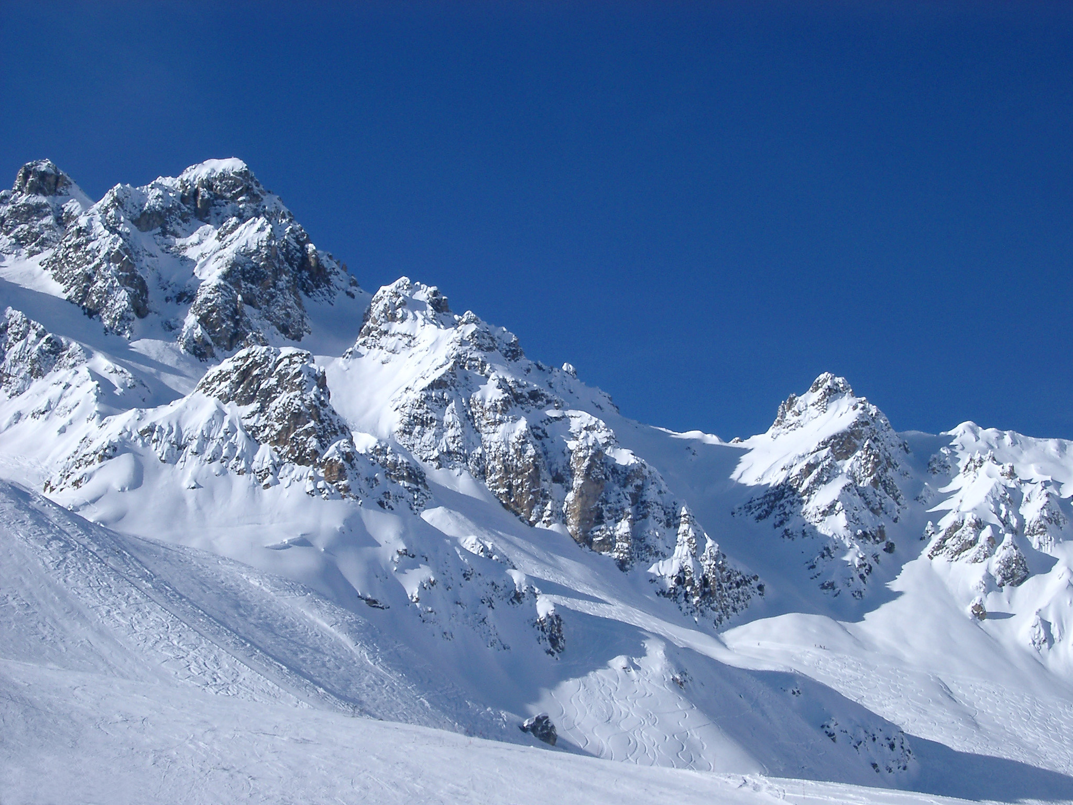
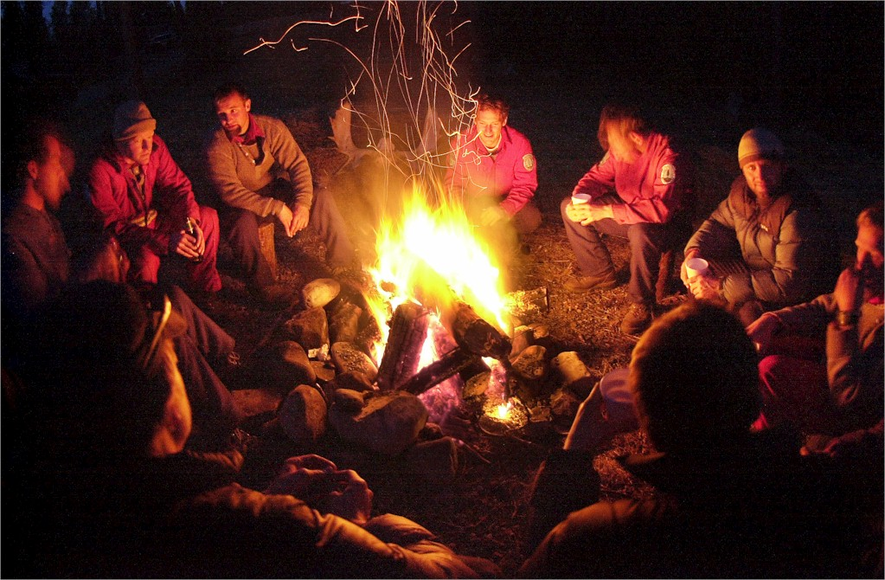
User Story
As an individual who wants to learn more about the outdoors and/or cooking
I want a one stop destination to learn about said topics, and follow the author on his journey
So I can expand my knowledge of the outdoors, learn new recipes, and get a real life account of experiences as a hunter

Slide 15
Use Cases
The user wants to know the best way to cook bear meat. They will visit the site and click recipes. On the recipes page they will then be able to search for all recipes that use bear meat as an ingredient. User can then click the recipe and view the full details for that specific recipe.
The user is curious as to the best ways to skin, and harvest an animal. The user can then click the media tab where pictures and informational videos are posted. User can then search for a video that discusses how to skin wild game animals and view the video. After watching the video the user will hopefully have a better understanding and can leave a comment.

Slide 16
Design, implementations, and Requirements

Slide 17
System Requirements Review
Risk Management Plan: Potential risks include the compromise of a user/admin account information. These risks will be mitigated by the use of Project Secrets to hide the admin accounts information, and the encryption of all users passwords.
Performance Requirements: Internet connection, web browser of choice, Operating System, and a computer
Computer Resource Estimates: Minimal amount of memory for the web application itself. Memory for operating system, web browser, etc. may vary

Slide 18
Implementations
Current Implementations
Blog page where various topics will be discussed
Media page to provide pictures and videos that will educate, and provide an experience that feels like the user was there
Gear page where I will review the equipment I use
Recipes page that will host the various recipes one can use to prepare wild game, and vegetables
Future Implementations
Google Map Web API that will provide the locations of various wild animals, and plants at a specific area
Mobile/Tablet friendly
Advertisments

Slide 19
In Retrospect
I am very pleased with the current scale of my project and the progress I have made. Having made the decision to start a new project, scalability was key when going through the Software Development lifecycle and I feel as though I have a very attainable goal now.
I would of rather began by creating a SQL database that was hosted on the cloud using Azure as opposed to creating a Local database. Switching from a local database to a database hosted to the cloud was a difficult task, and prevented me from hosting my web application to the cloud for some time but I learned a lot from the experience. I also would of rather implemented Project Secrets earlier when creating role authorization.

Slide 20
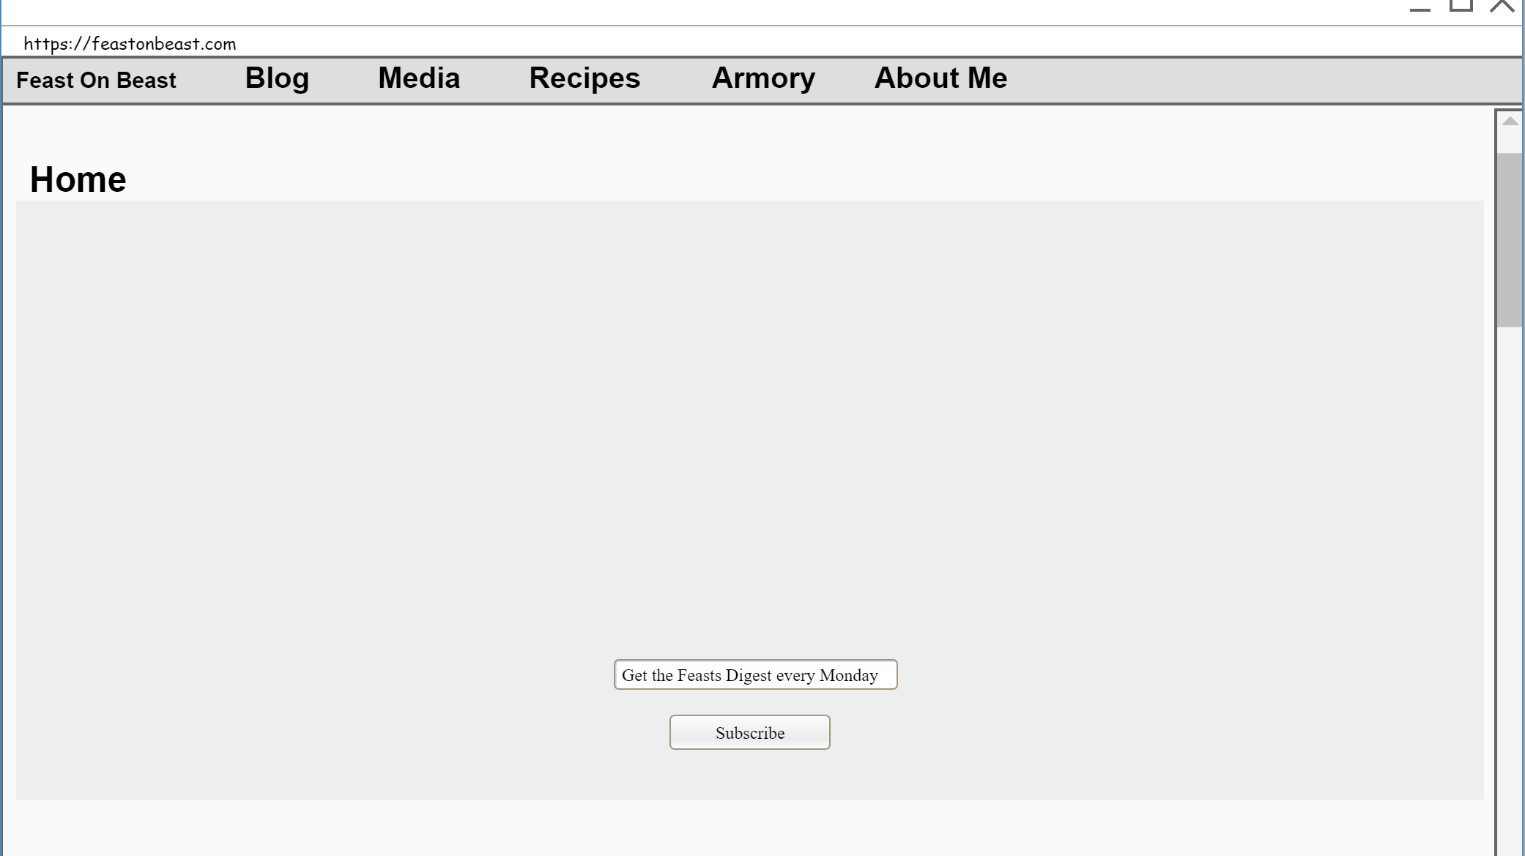
Draft User Interface

Slide 21
Test Readiness Review
Objectives for testing are to ensure the development of the web app is sticking to the basics of object oriented programming, as well as confirming functionality
Currently not ready to begin testing due to incomplete unit tests, however I have confidence that most unit tests will be implemented in the next 2 weeks
All planned tests are properly resourced, and can be done by both my admin account, as well as user account
Risks of unit tests are minimal as all precautions to prevent data leaks or account comprises have been taken
All unit tests are expected to run successfully, resulting in assurance that all functions route properly, and /or function as intended

Slide 22

Thank you
Tyler.Ballard1@outlook.com

